Slide 1

LLM Powered SOC Assistant
A Natural-Language-Driven Security Analysis Platform
CSIS4495 – Applied Research Project
Umesh Kalupathirannehelage

Slide 2
Introduction
Security Operations Centers (SOCs) deal with complex logs and high alert volume.
Analysts spend significant time writing queries, searching events, and correlating incidents.
This project builds a natural-language-to-SQL SOC Assistant powered by an LLM and Wazuh to:
Simplify log analysis
Reduce query-writing effort
Provide instant insights, charts, and summaries
Assist junior analysts with decision-making

Slide 3

Problem Statement
Traditional SIEM queries require:
Technical expertise
Knowledge of log schemas
Time to manually filter & correlate events
SOCs often face:
Alert fatigue
Inconsistent triage
Slow manual investigations
Need: An intelligent assistant that understands queries like a human.

Slide 4
Project Objectives
index=ossec sourcetype="wazuh:alerts"
| spath path=rule.description output=rule_desc
| spath path=data.srcip output=src_ip
| spath path=agent.name output=agent
| spath path=rule.level output=severity
| search rule_desc="*sshd*" (rule_desc="*failed*" OR rule_desc="*invalid*" OR rule_desc="*denied*")
| bin _time span=10m
| stats count AS failed_attempts values(agent) AS agents_used by src_ip, _time
| where failed_attempts > 20
| sort - failed_attempts
Build an end-to-end SOC analysis system integrating:
Wazuh for log collection
ETL pipeline for ingestion + normalization
PostgreSQL database for structured analysis
FastAPI backend for APIs
Ollama LLM to convert natural language → SQL
Custom web UI for visualization
Provide charts, insights, summaries, severity distribution, and agent filtering.
“Show brute force attempts in the last 10 minutes.”

Slide 5
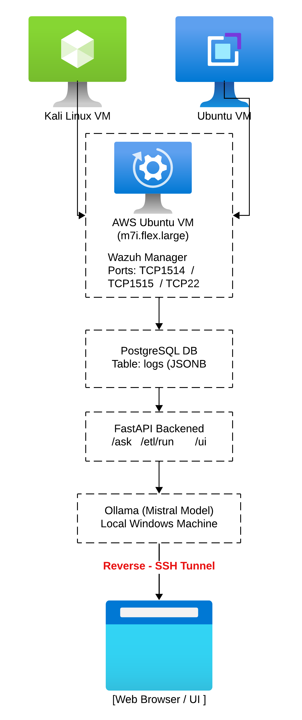
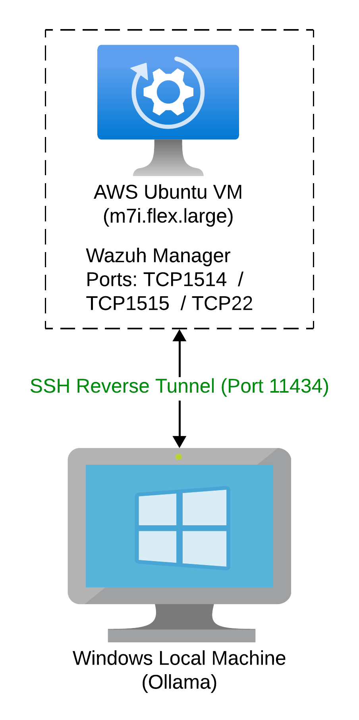
System Architecture

Slide 6



Component 1: Log Collection with Wazuh
Deployed Wazuh Manager on AWS
Added two agents: Ubuntu and Kali
Configured log sources:
/var/log/auth.log
/var/log/syslog
journald
nginx/apache logs
dpkg logs
Enabled modules: syscollector, rootcheck, syscheck, SCA
Ensures diverse, realistic security events for the assistant.

Slide 7
Component 2: ETL Pipeline
Python script processes alerts from:
/var/ossec/logs/alerts/alerts.json
Extracts:
timestamp, agent, rule, IP, username, rule level, description
Normalizes into PostgreSQL logs table
Includes:
Duplicate prevention
Error handling
Timestamp normalization
Supports manual run and cron-based hourly ingestion.

Slide 8

Component 3: FastAPI Backend
Key endpoints:
/ask → Natural language → SQL → DB results
/etl/run → Manual ETL execution
/etl/status → Last + next ETL run
/stats/severity → Severity distribution
/filters/agents → Dynamic dropdown list
Fully secured: blocks UPDATE/DELETE/ALTER etc.
Validates SQL, measures latency, and returns JSON.

Slide 9

Component 4: Ollama LLM Integration
Local model: Mistral 7B
Schema hints
Keyword → rule_desc mappings
Severity mapping
SQL rules and restrictions
Generates a clean SELECT query only
Supports:
SSH failures
Sudo events
Kernel messages
Authentication logs
Top src_ip
Chart generation logic
Ensures safe, predictable SQL responses.
Receives system prompt with:

Slide 10
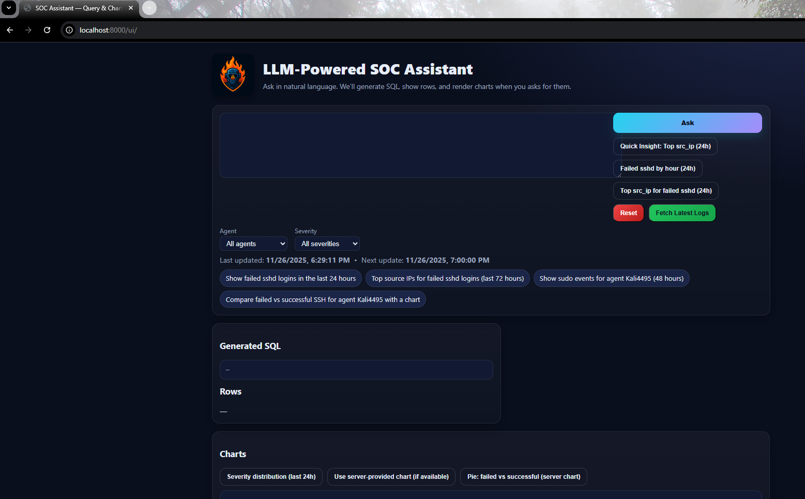
Component 5: Frontend UI
Built with HTML, CSS, JS
Features:
Natural language input
Dynamic loading spinner
Error panel
SQL preview
Table results
Charts (Chart.js)
Agent & severity filters
Auto-updating ETL timestamps
Dark, professional theme

Slide 11

Implemented Feature Summary
LLM-driven natural language → SQL
SSH failed vs successful chart
Severity distribution chart
Agent-based filtering
Cron-based ingestion automation
ETL timestamp display & auto-refresh
Top attacker IPs for SSH
Sudo activity, anomaly events, kernel logs support

Slide 12

Live Demo

Slide 13
Conclusion
Successfully built a fully functional mini-SIEM assistant
Converts natural SOC questions → SQL → insights
Reduces complexity for junior analysts
Provides real-time visibility into security events
Demonstrates how LLMs can support SOC automation

Slide 14

Questions & Answers

